Slide 1
“Nito” Requirements stage
Course-Section: CS102-03
Group: 3B
Group name: Internationals
Group members:
Ziya Mukhtarov, Javid Baghirov, Mokhlaroyim Raupova, Adeem Adil Khatri, Alper Sari, Mannan Abdul
Assistant: Mehmet Başaran
Notes:
Mohi

Slide 2
Outline
How did we come up with the idea?
The main features of Nito
Features Of Nito in details
Similar applications
Why use Nito?
Q&A and your suggestions
Notes:
Mohi

Slide 3
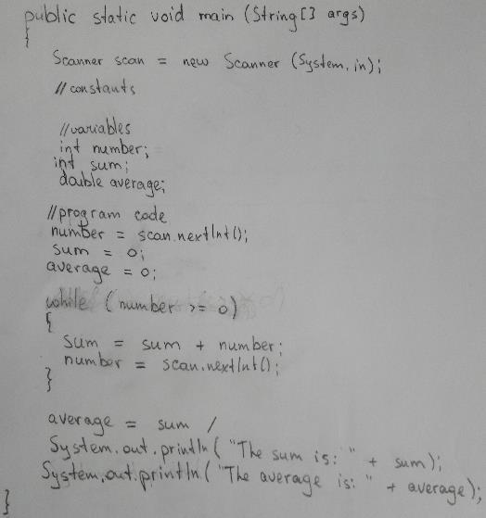


Your biggest problem in CS101/102
Oh I need to count the numbers! How did I forget it?!
I need to erase whole code now…
Handwritten coding exams!
Why? What problems did you encounter?
Having to delete the whole code in order to fix a very small mistake
Precise indentations
Trying to write cleanly
Notes:
Mohi

Slide 4

Why instructors choose to “torture” us in this way?
Use of technology means more cheating opportunities
They want to test what we know, not what technology can do
It’s not torture for us, it’s to make exams fair for everyone!
Institutions other than Bilkent University make use of written programming exams.
Notes:
sunny

Slide 5
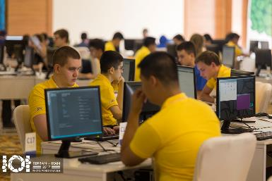
Nito – The elegant solution for these problems!
Easy to use exam system
Solves issues for examinees…
Code to be typed on the computer
Easy indentation using TAB
and examiners
Creates a secure environment for exams
Increases safety by using a number of security services
Provides students with minimal interface imitating a paper
Makes it easier to grade papers (no need to read ugly handwritings)
Notes:
Alper

Slide 6
Details
Two different interfaces
For administrators: Create / invigilate / grade exams
For examinees: Solving questions
Notes:
Sunny

Slide 7

Details: Nito - Administrator Exam preparation
Create new exams
Add information pages, questions and their solution templates
Export/import functionality
Workspace selection
Auto-save feature
Notes:
Sunny

Slide 8
Details: Nito - Administrator During exam
Different view showing color-coded log of important events
Ability to extend the exam time
Possibility of sending notifications to selected examinees
Two different main views:
Simple view: Contains a table showing all relevant information neatly
Monitoring view: Real-time screen view of all examinees, ability to open focused view by clicking on some screen preview
Focused view: Shows only one screen with functionality of adjusting the quality
Notes:
Javid

Slide 9

Details: Nito - Administrator After the exam
Easy to use grading system
Auto code-coloring for better visualization
Option to compile the program and see compile-time errors
Ability to test all solutions against Moss (Measure Of Software Similarity) plagiarism service by Stanford University
Option to export grades (and directly upload to stars/moodle?)
Notes:
Javid

Slide 10

Details: Nito - Examinee Security precautions
Full screen only
Limited keyboard usage
Auto live screen-share with administrator
New device connection during exam notifies admins
Newly opened processes notifies admins
Notes:
Ziya

Slide 11
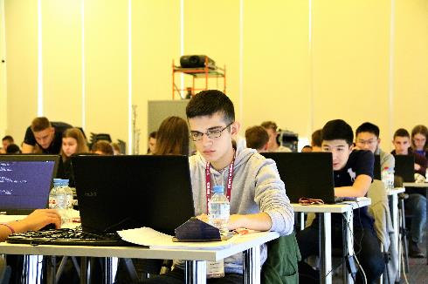
Details: Nito - Examinee During the exam
As simple as using a text editor
Ability to work with multiple files at a time
Auto-saving solutions to be used in case of failures
Notes:
Alper

Slide 12


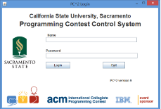



Similar applications
Veyon
Screen-sharing and notification sending features
CMS/PC^2
Programming Contest Management System
Notepad++
Simple code editor
Turnitin
Plagiarism checker
Eclipse
Project Manager
Code compiler
Notes:
Ziya

Slide 13
Why use “Nito”?
Nito combines features of different applications.
The end result is a unique application.
As such, Nito is perfect for any exam situation (interviews, school exams etc.)
Notes:
Mohi

Slide 14



Do your best!
Notes:
Everyone

